Slide 1
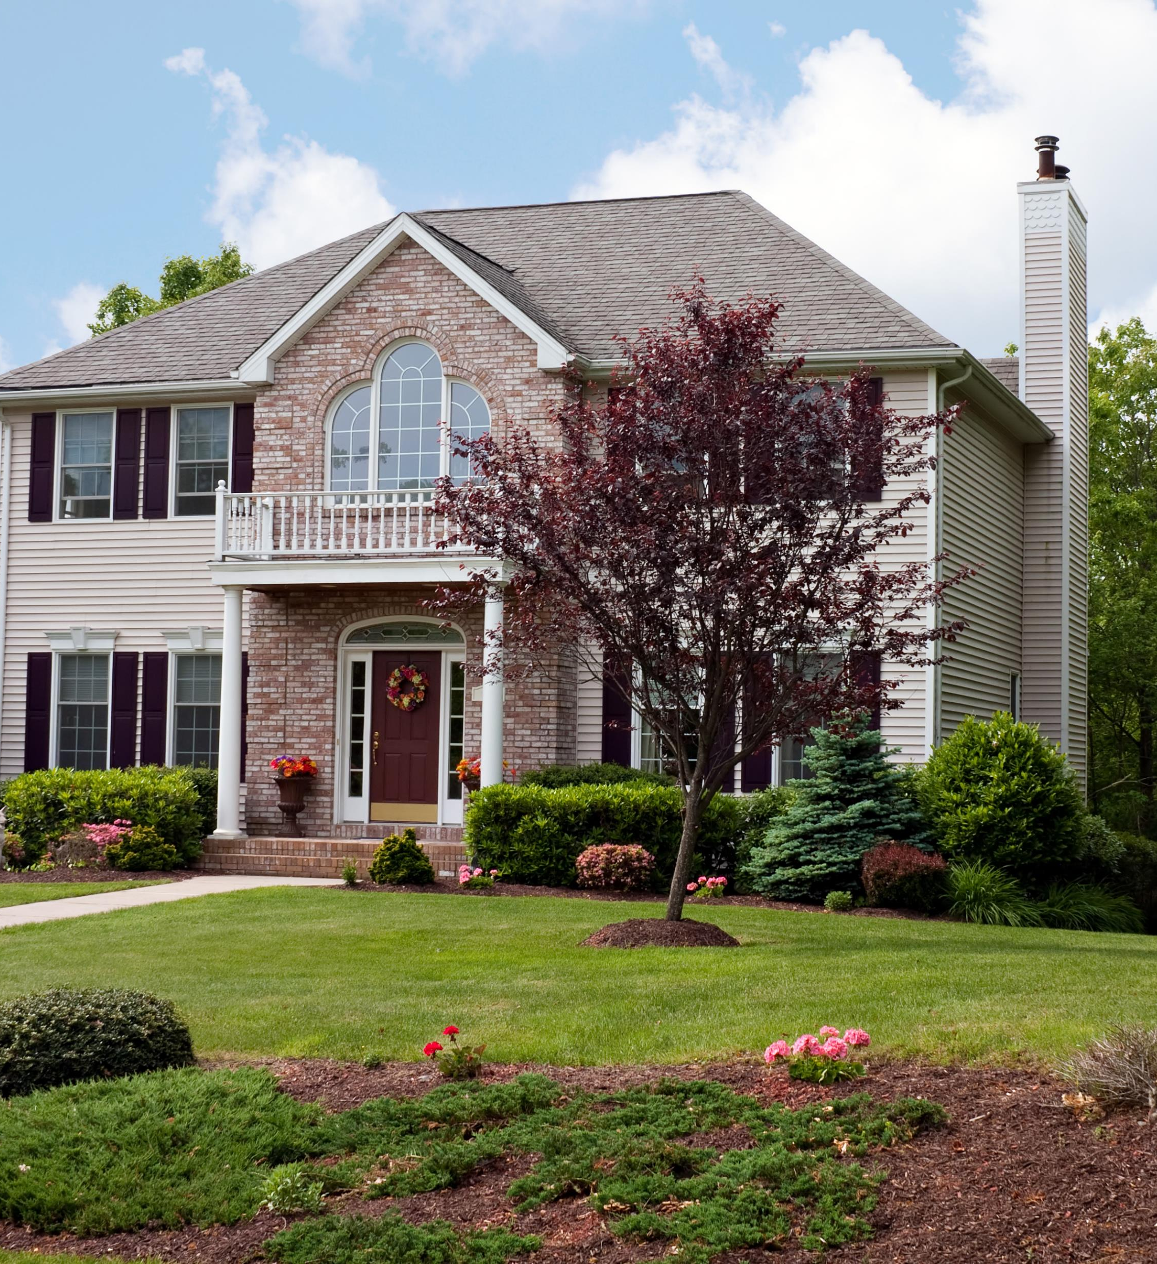
Texas Real Estate predict house prices based on various real estate features using Machine Learning Presented by: Rebecca, Natalie, Russell, Michael, Trinity
Group 3 Project 2
Aug 11, 2024

Slide 2

Executive Summary
This project aims to develop a machine learning model to predict house prices based on various real estate features. The dataset contains essential information about houses, such as the number of bedrooms and bathrooms, lot size (in acres), house size (in square feet), and geographic location (city, state, and zip code). Additionally, key variables include the previous sale date, the house's age since the last sale, and the average house value in the corresponding zip code area. This project will provide valuable insights into real estate pricing, enabling stakeholders to make informed, data-driven decisions based on housing trends across different geographical regions.
Project Goals
Data Preprocessing: Prepare and clean the data, including handling missing values, encoding categorical variables (city, state, zip code), and scaling numerical features.
Model Development: Train machine learning models on the dataset to predict house prices (either as price per square foot or total house price). Potential models include Linear Regression, Random Forest, and Gradient Boosting.
Model Evaluation: Use a variety of metrics such as Mean Absolute Error (MAE), Mean Squared Error (MSE), and R-squared (R²) to evaluate model performance and refine it for accuracy.
Feature Importance: Identify the most important factors affecting house prices, such as location, house size, or lot size, and provide insights into market trends.
Predictive Analysis: Once a final model is selected, use it to make predictions on unseen data to assess its robustness in a real-world scenario.

Slide 3
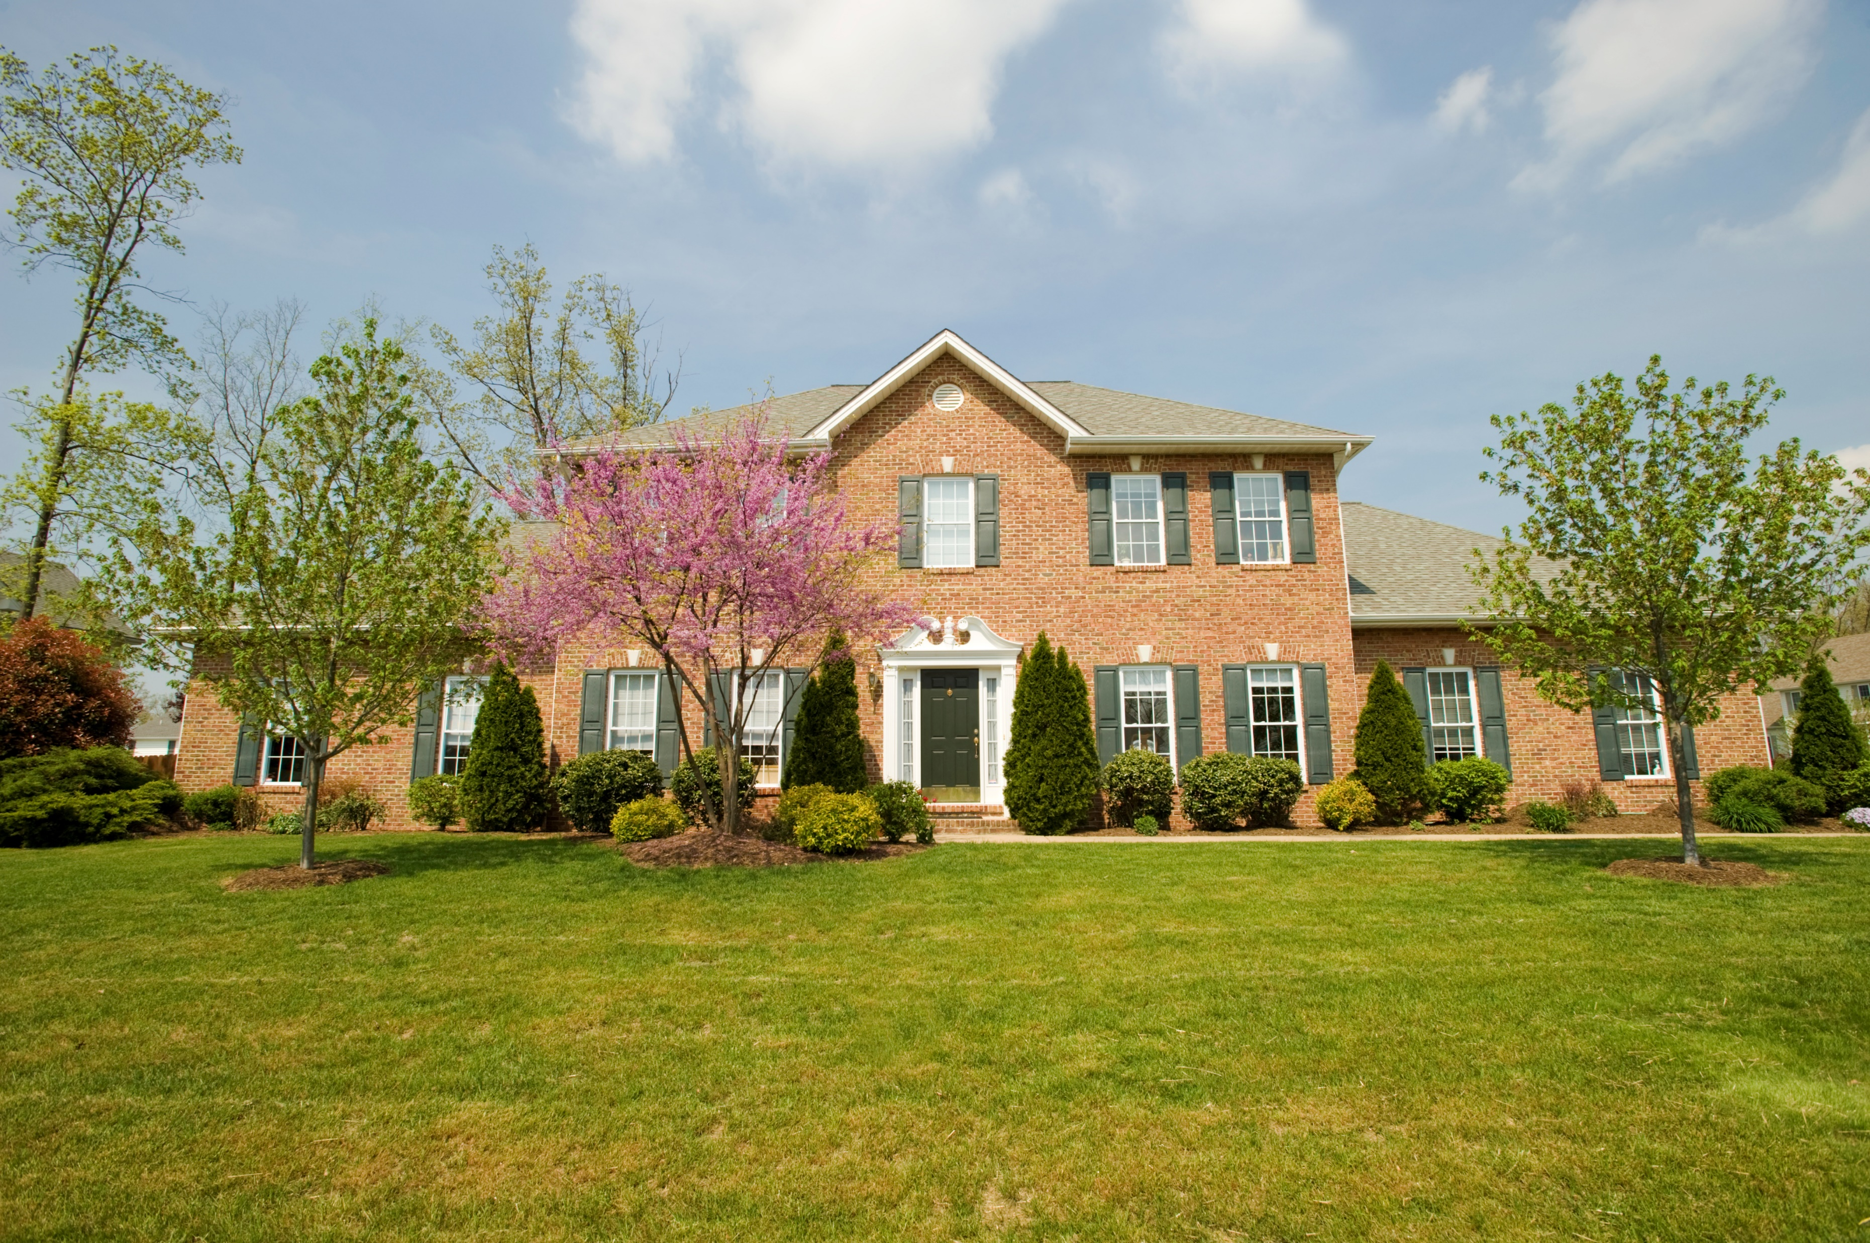
Dataset
USA Real Estate Dataset features real estate listing across the United States, categorized by State and Zip code. The original dataset, sourced from Kaggle, contained 2.2 million entries. We narrowed down the data by focusing exclusively on properties in Texas, resulting in a reduced dataset with 12 columns and 40,111 rows.
Data Exploration and Cleaning
In the data exploration phase, we thoroughly examined the dataset to understand its structure, variable types, and key statistics. We utilized visualizations like histograms and scatter plots to identify patterns, relationships, and outliers in the data.
For data cleaning, we addressed missing values, removed duplicates, and ensured correct data types for each column. We also dropped the columns we don’t need for data analysis. The cleaned dataset was then validated and prepared for further analysis or modeling.
Data Transformation
Feature Engineering:
We create a new features that could capture important relationships:
We calculate the age of the house since it was last sold
Calculate the Price per square foot
Calculate the average house value per zip code
Convert categorical variables: Convert city, state, and zip code into numerical values using label encoding.
Model Development

Slide 4
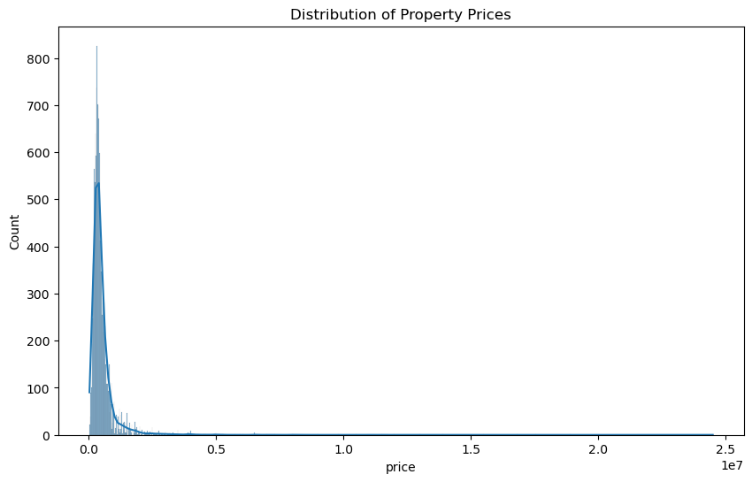
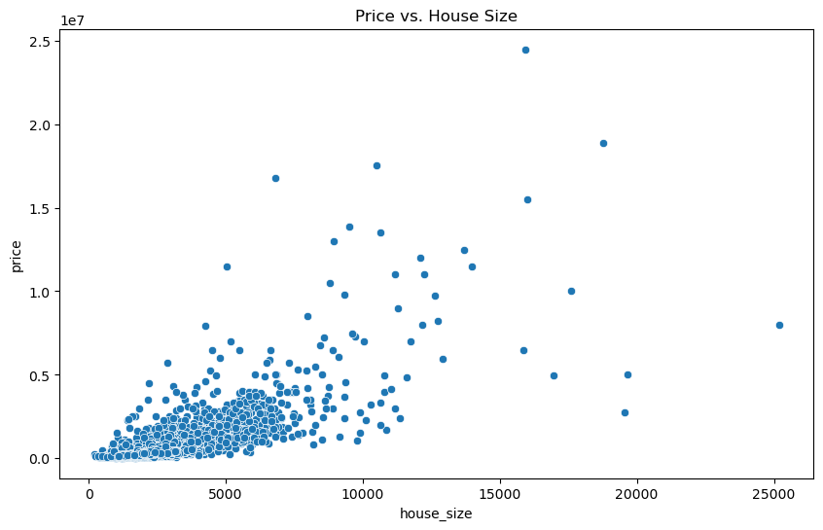
Visualization
Histogram of Prices
Most properties are low to moderately priced:
The sharp peak at the lower end suggests that the majority of the properties in the dataset are within a more affordable price range.
Few high-priced properties:
The long tail on the right indicates that there are some very high-priced properties, but they are rare compared to the lower-priced ones.
Scatter plot of Price vs. House Size
Positive Correlation:
Generally, there is a positive correlation between house size and price. This means that as the house size increases, the price tends to increase as well. This is evident from the upward trend where larger houses generally correspond to higher prices.
Cluster of Points:
Most of the data points are clustered in the lower range of both house size (under 5,000 square feet) and price (under $500,000). This suggests that the majority of properties in the dataset are relatively smaller homes with lower prices.
Outliers:
There are several points scattered far away from the main cluster, especially at higher house sizes and prices. These represent large, luxury properties that are much more expensive than the average. Some outliers are particularly notable for having high prices even with a relatively smaller house size, or very large house sizes with prices that may seem disproportionately high or low compared to the main trend.

Slide 9
If given more time we want to:
Input New Data: We will create a new listing for each property, data such as the number of bedrooms, bathrooms, lot size, house size, location (city, state, zip code), and previous sale date are available.
Apply Preprocessing: Preprocess the new data as what we did with the training data, ensuring that categorical variables are encoded, and numerical features are scaled properly.
Predict House Prices: Using the final, best-performing model, we will predict the expected market price (price per square foot or total price) for each property based on the input features.
Comparison with Listed Prices: Once we have the predicted prices, will compare them with the actual listing prices of the properties. If the predicted price is significantly higher than the listing price, that property could be underpriced and a good investment opportunity.

Slide 10
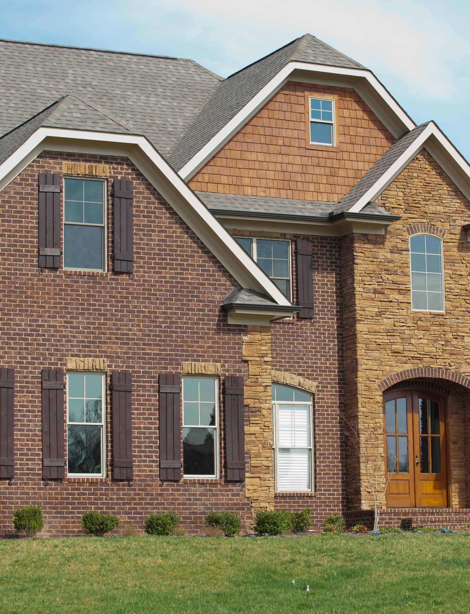
THANK YOU
Links:
Dataset: Housing Market & Prices (kaggle.com)
Github Link: https://github.com/trentlerma/groupthreeproject.git
GitProject: https://github.com/trentlerma/groupthreeproject.git

